Slide 1
SNR study P1-N1-P2 ERP
Age: mean=65 (31-79)
PTA levels: mean=38 (12.5-54)
Hearing aid users. >7 hours a week
n=29
ERP preprocessing
Resample to 250hz. Load channel locations=Neuroscan65.elp. Epoch data for clean ba’s. Run ICA=fastica. Remove bad components. Remove bad epochs. Rereference to average. Filter high pass=1hz, low pass=30hz.
Protocol:
250 Clean ba’s [MMBF7] with no noise. Sound level 30 db above PTA

Slide 2
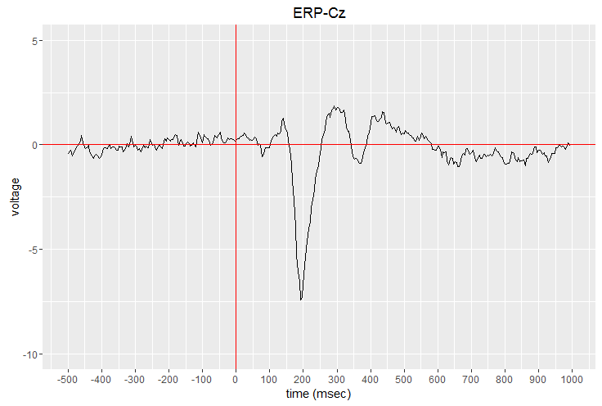
Subject 1018

Slide 4
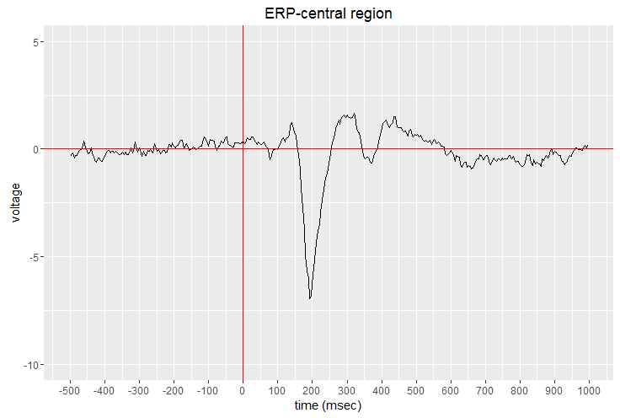
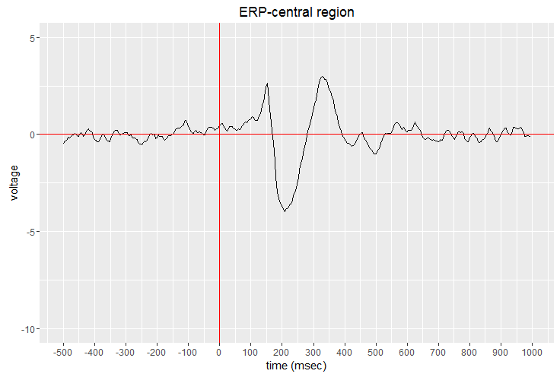
1018
1019

Slide 5
Questions
Preprocessing appropriate?
[Kate] How do SNR ERPs compare to normal hearing subjects, HL w/o HA and HL w/HA?
200 ms delay in N1
Defining ROI
Grand averaging by condition

